Slide 1

CAPSTONE PROJECT : HEALTHCARE FORECASTING AND RESOURCE ALLOCATION
BY: PARUL GHAI
pg611

Slide 2

Introduction
Hospitals face challenges in optimizing resources like rooms, staff, and equipment to meet patient care demands effectively.
Reliable data-driven solutions are essential for balancing resource allocation and improving operational efficiency.
The Covid-19 pandemic highlighted significant gaps in healthcare management, emphasizing the need for predictive analytics to enhance preparedness and resource planning.

Slide 3

Hospitals struggle with inefficient resource allocation, leading to overcrowding or underutilization of critical resources like rooms, nurses, and doctors. Accurately predicting patient length of stay (LOS) is challenging due to variability in patient demographics, admission types, and illness severity. Balancing operational efficiency while maintaining high-quality patient care requires robust predictive models and actionable insights.
Problem Statement

Slide 4

OBJECTIVE
Predict patient Length of Stay (LOS) using historical data.
Identify factors influencing LOS.
Provide actionable insights for hospital resource optimization.
Enhance healthcare efficiency and patient care quality.

Slide 5
Dataset Overview
Column | Description
case_id | Case_ID registered in Hospital
Hospital_code | Unique code for the Hospital
Hospital_type_code | Unique code for the type of Hospital
City_Code_Hospital | City Code of the Hospital
Hospital_region_code | Region Code of the Hospital
Available Extra Rooms in Hospital | Number of Extra rooms available in the Hospital
Department | Department overlooking the case
Ward_Type | Code for the Ward type
Ward_Facility_Code | Code for the Ward Facility
Bed Grade | Condition of Bed in the Ward
patientid | Unique Patient Id
City_Code_Patient | City Code for the patient
Type of Admission | Admission Type registered by the Hospital
Severity of Illness | Severity of the illness recorded at the time of admission
Visitors with Patient | Number of Visitors with the patient
Age | Age of the patient
Admission_Deposit | Deposit at the Admission Time
Stay | Stay Days by the patient (Target Variable in Train Set)
The dataset for this project was accessed from the kaggle janatahack healthcare analytics competition. It comprises two primary files: one for training (train.Csv) and another for testing (test.Csv).
The train dataset consists of 318439 entries and 18 columns. Here is a brief overview

Slide 6

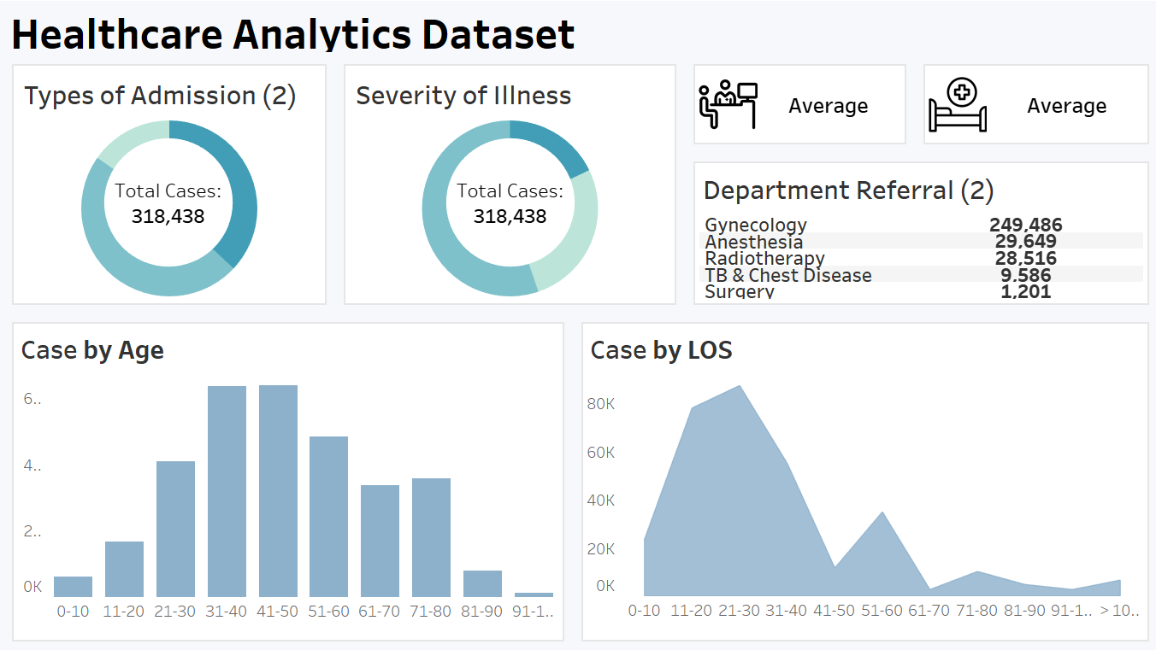
EXPLORATORY DATA ANALYSIS
Dataset Analysis

Slide 7
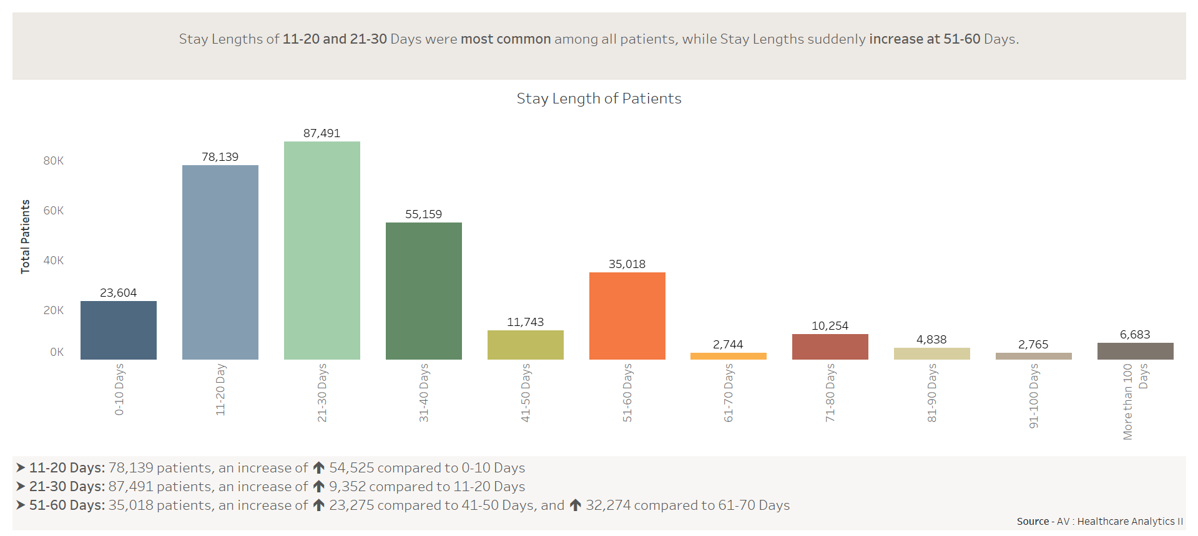
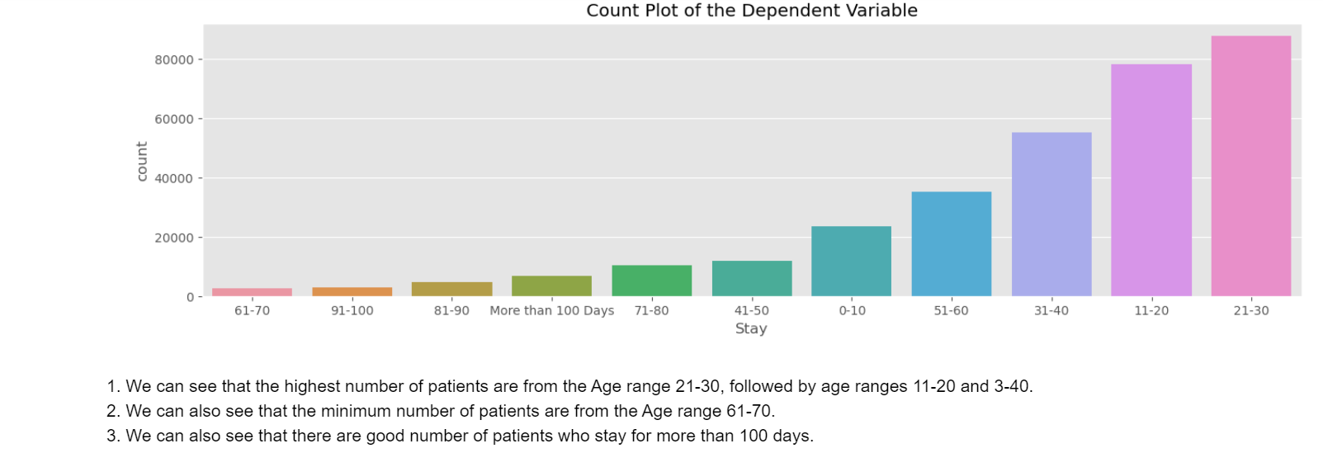
Dependent Variable
Stay Distribution: The Stay column was analyzed to understand the frequency of various stay durations.

Slide 8
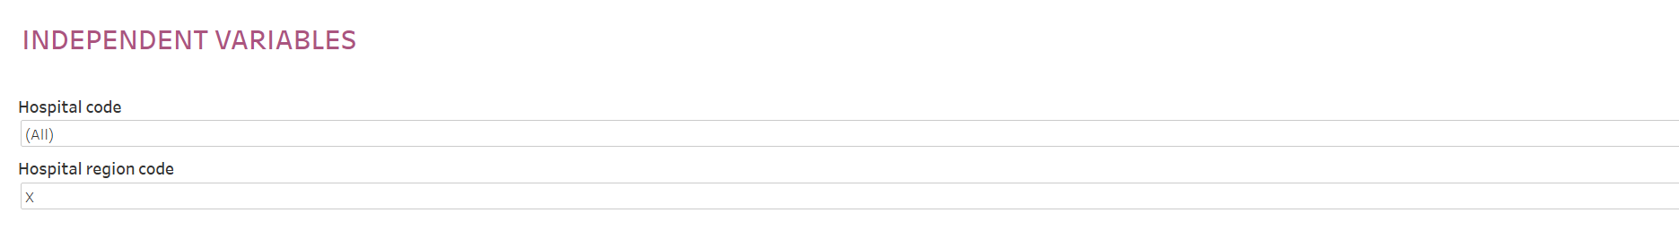
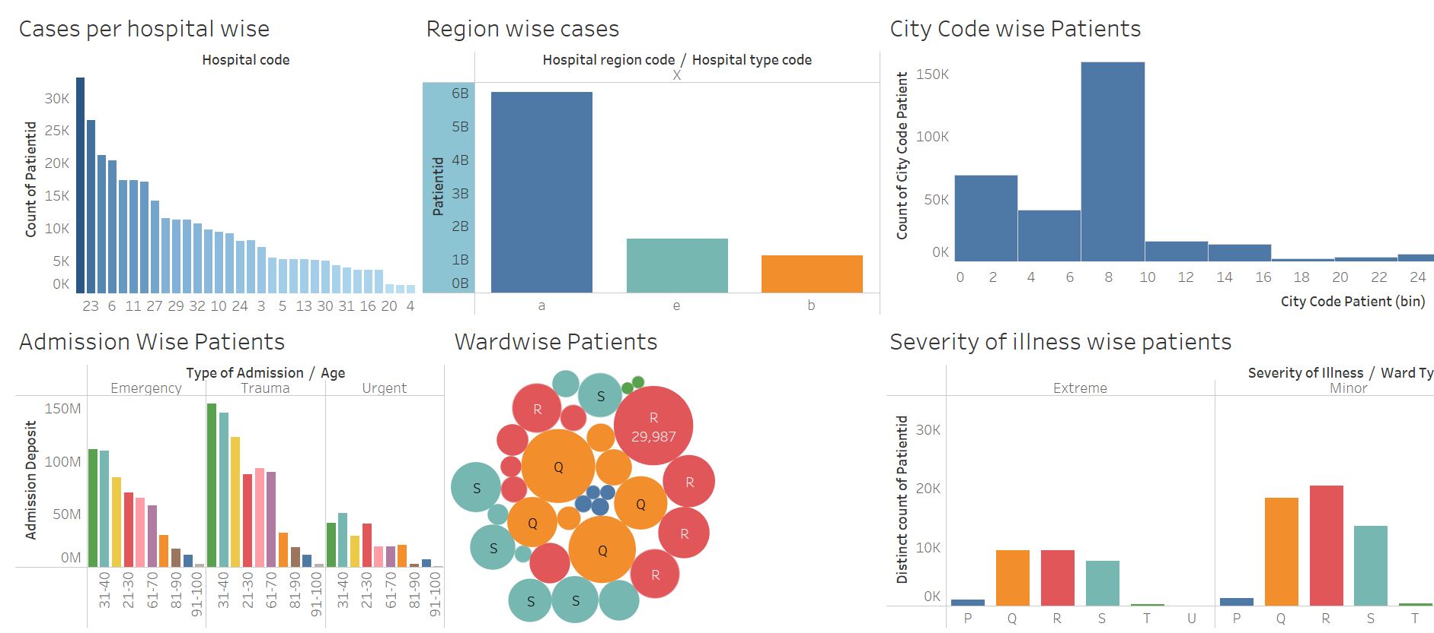
INDEPENDENT VARIABLES
Hospital-Specific Variables:
Hospital Code: Unique identifier for hospitals.
Hospital Type and Region: Helps categorize operational scale and geography.
Available Extra Rooms: Indicates hospital capacity.
Patient-Specific Variables:
Age: Critical factor influencing recovery time.
Severity of Illness: Affects length of stay and resource needs.
Admission Type: Emergency, Trauma, or Scheduled.
Other Features:
Department: Overseeing patient care (e.g., Surgery, Gynecology).
Visitors with Patient: Impacts hospital traffic and resources.
Admission Deposit: Linked to cost and resource usage.

Slide 9
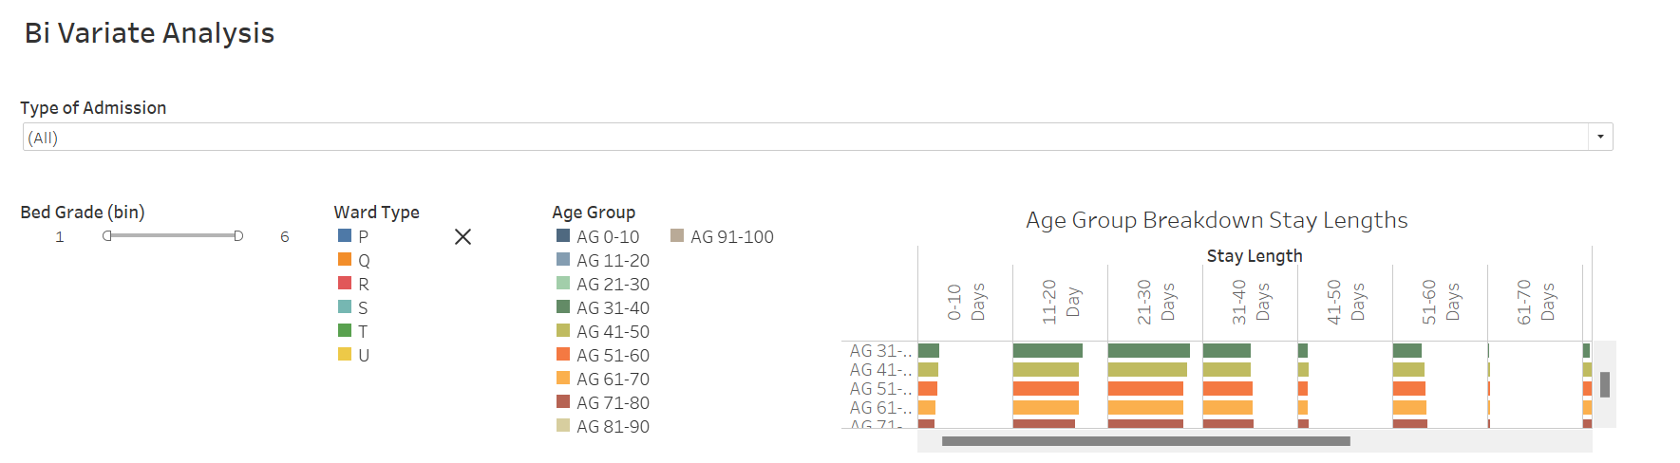
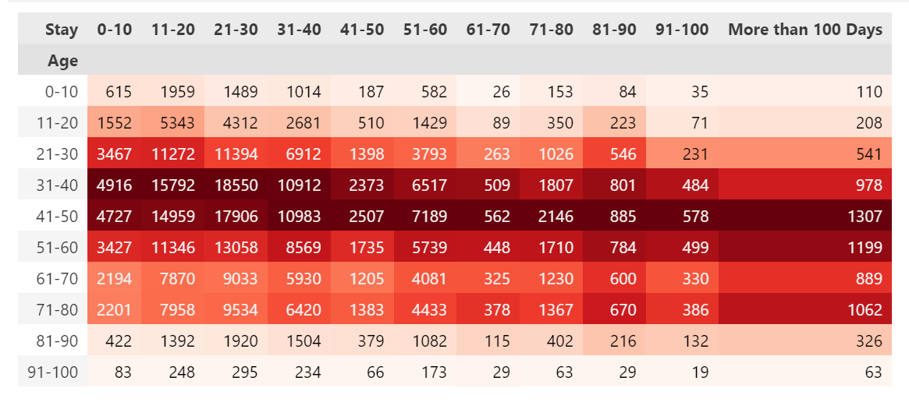
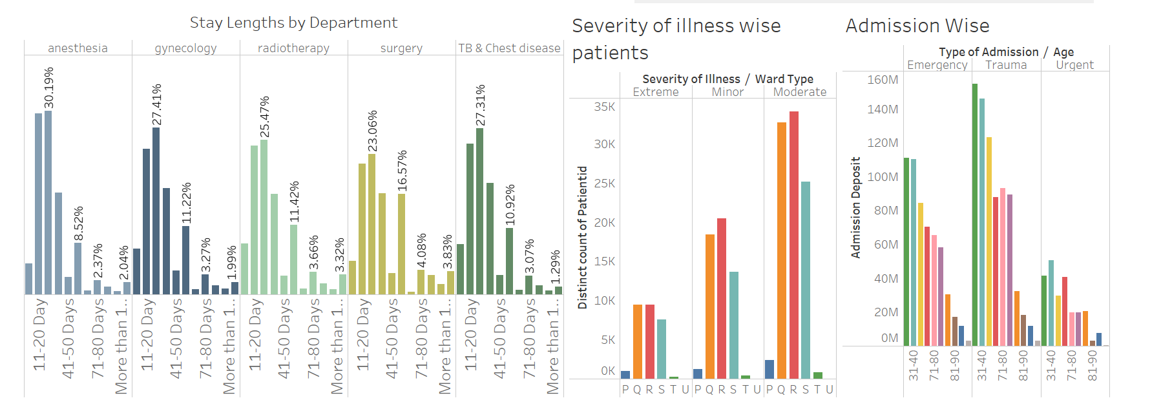
BI VARIATE ANALYSIS

Slide 10

Data cleaning
Renamed Columns:
Updated column names for better readability and understanding (e.g., changing case_id to a descriptive format).
Dropped Irrelevant Columns:
Removed case_id and other non-influential features.
Handled Missing Values:
Imputed missing values in critical variables like Bed_Grade and City_Code_Patient using the mode to maintain data consistency.

Slide 11
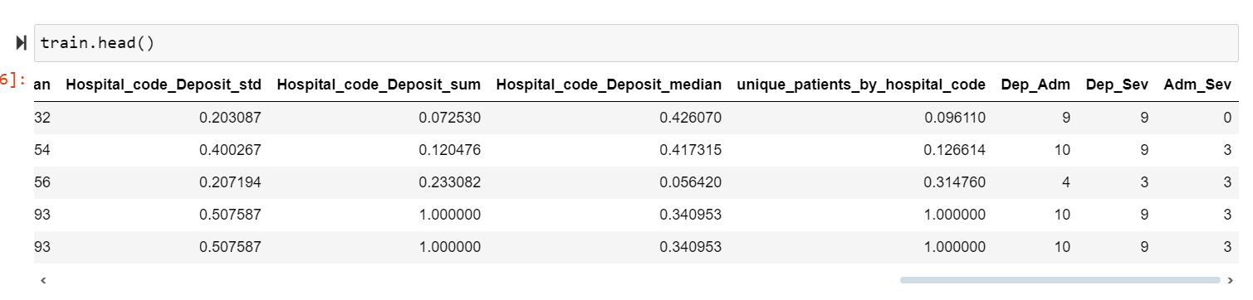
Feature Engineering
Interaction Features: Created new variables combining existing ones, e.g., Dep_Adm (Department + Admission Type), Dep_Sev (Department + Severity).
Aggregate Statistics: Calculated summary statistics (mean, sum, etc.) for Deposit grouped by Hospital_code to capture hospital-level resource dynamics.
Patient-Specific Attributes:Added features like the number of unique hospitals visited or departments interacted with to understand patient behavior.

Slide 12
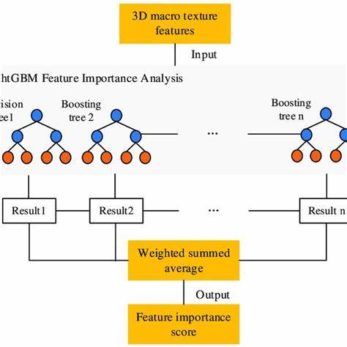
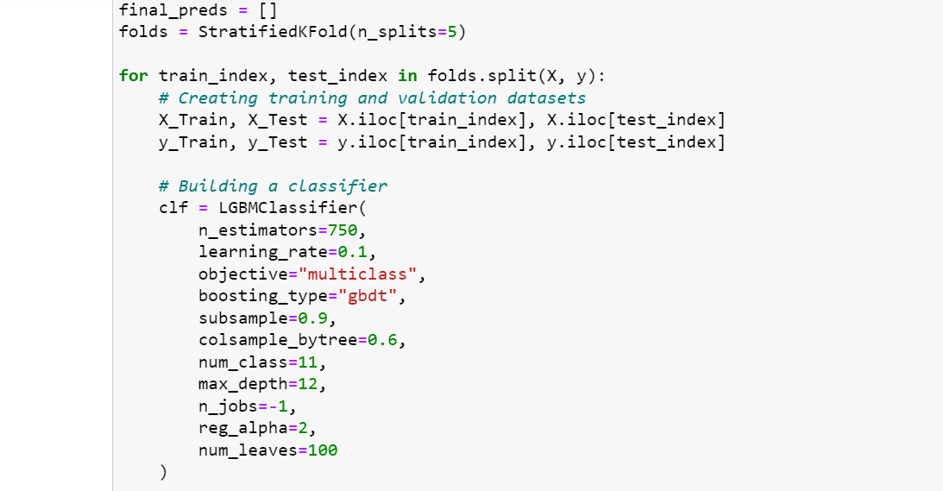
Why LightGBM ?
Efficient with Large Datasets
Handles Multiclass Classification
Minimized Preprocessing Requirements
Customizable Hyperparameters
Evaluation Metrics

Slide 13
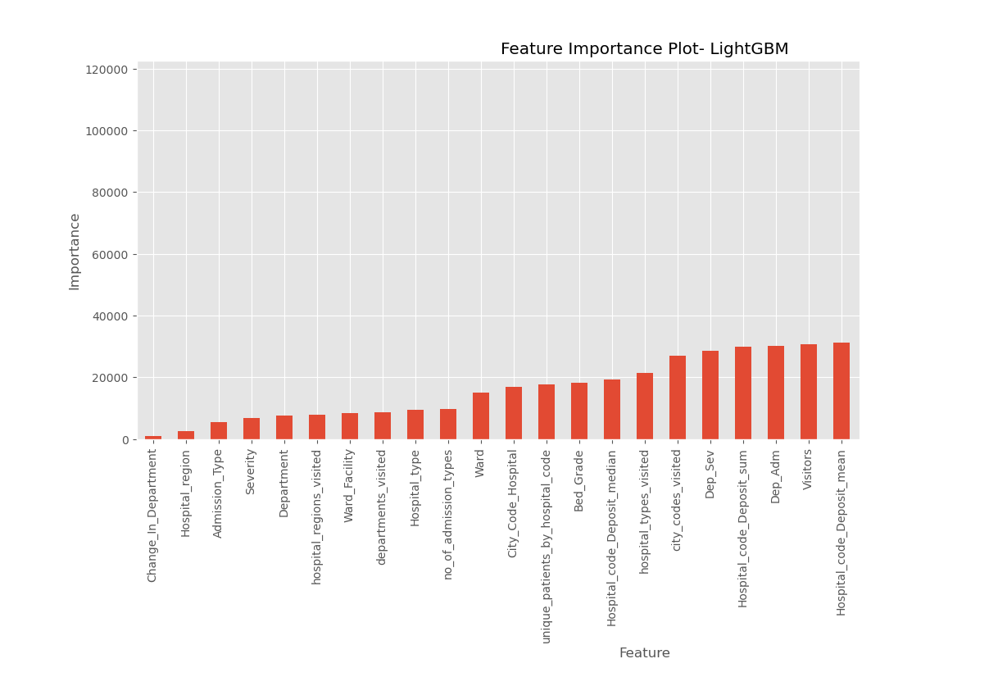
FEATURE IMPORTANCE
Admission_Deposit: The financial deposit at admission played a significant role in determining LOS.
Severity of Illness: The severity level (Minor, Moderate, Extreme) strongly correlated with longer stays.
Age: Older patients generally exhibited longer stays due to slower recovery rates.
Hospital_type_code: Certain types of hospitals had higher LOS rates.
Type of Admission: Emergency and Trauma admission types contributed significantly to LOS predictions.
Bed Grade: Higher or lower bed grades influenced recovery durations.
Ward Type: Patients in Ward Types R and Q had higher LOS.

Slide 14
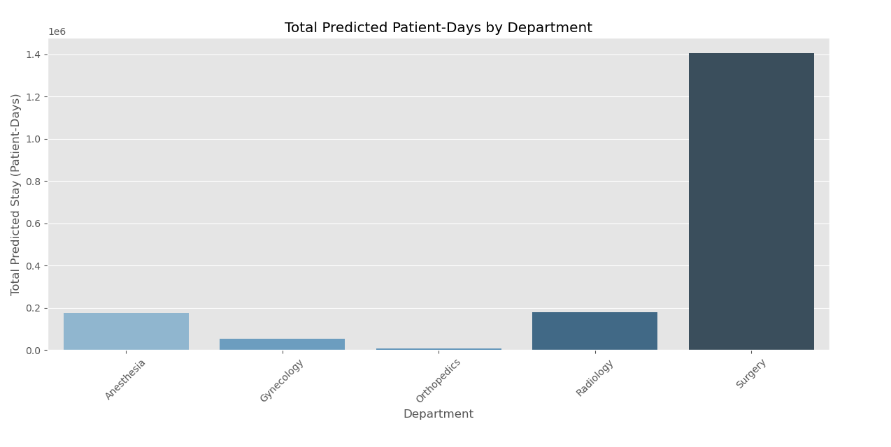
PREDICTED STAY BY DEPARTMENT
The Surgery department dominates total predicted stays, suggesting that patients undergoing surgical treatments have prolonged recovery periods. This emphasizes the need for dedicated post-surgery wards, optimized surgical planning, and higher resource provisioning (nurses and doctors).
Anesthesia and Radiology departments also exhibit significant patient-days, likely due to preoperative care or imaging needs. This insight can help hospitals focus on scheduling efficiency and integrating these departments into surgical workflows.
The Gynecology and Orthopedics departments have relatively lower patient-days. However, these departments still require adequate short-term room allocation to cater to frequent admissions.

Slide 15
RESOURCE CALCULATION
Required Rooms = Total Patient-Days / 10
Required Nurses = Total Patient-Days / 5
Required Doctors = Total Patient-Days / 20

Slide 16
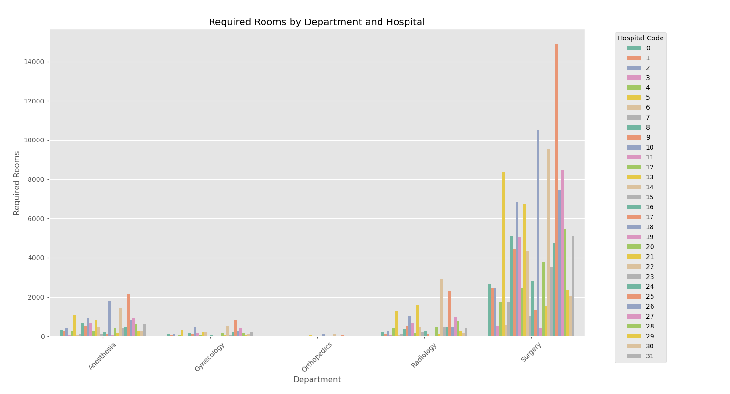
REQUIRED ROOMS BY DEPARTMENT

Slide 17
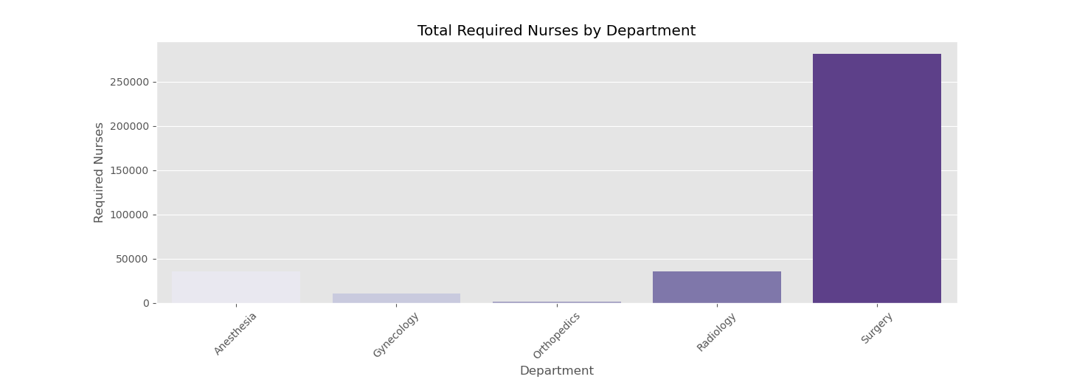
REQUIREMENT OF NURSES BASED ON EACH DEPARTMENT
• The Surgery department requires disproportionately high nurse availability due to longer stays and intensive post-operative care. Radiology and Anesthesia also show moderate nurse requirements for ongoing treatments.

Slide 18
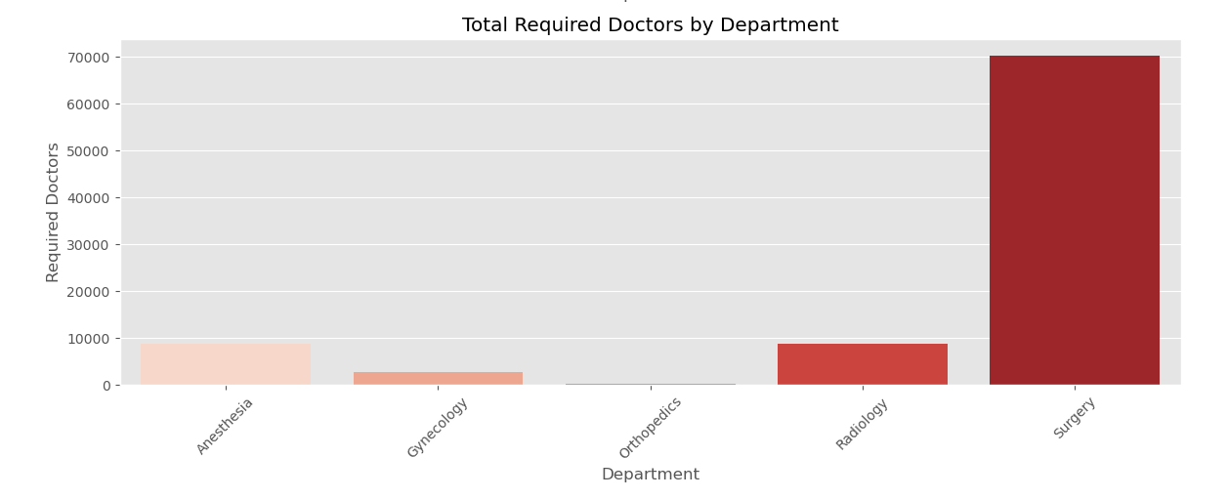
REQUIREMENT FOR DOCTORS BASED ON EACH DEPARTMENT
• The Surgery department again dominates in required doctor counts, reflecting the criticality of surgical procedures and patient monitoring needs. Anesthesia comes next, which aligns with the complexity of preoperative and intraoperative care.

Slide 19
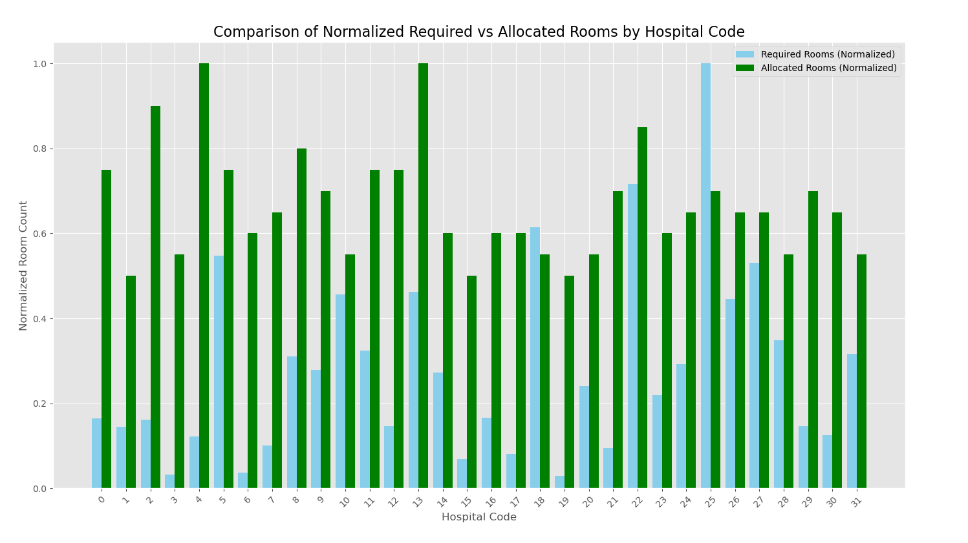
REQUIRED ROOMS VS ALLOCATED ROOMS
• Several hospitals had significant gaps between required and allocated rooms.
• The visualizations reveal resource gaps where required rooms significantly exceed allocated rooms, particularly in Surgery departments and hospitals with codes 26, 23, and 5.
• Hospitals in certain regions (like Region X) face consistent room shortages, indicating that urban hospitals may experience higher patient inflow than rural ones.

Slide 20

Key findings and insights
Surgery Department: Surgery requires the most resources (rooms, nurses, doctors) due to extended patient stays and recovery durations.
Resource Demand Trends Across Regions: Hospitals in Region X consistently experience higher resource shortages compared to Regions Y and Z. This could be due to a higher patient inflow and resource constraints.
Resource Gaps: Hospitals with fewer extra rooms often face severe mismatches in resource allocation.
LOS by Age Group: Patients in the 41-50 age group showed significant LOS, particularly in Surgery and Anesthesia departments.
Resource Bottlenecks: The Surgery department poses a critical resource bottleneck due to prolonged patient recovery periods.
Regional Challenges: Hospitals in high-demand regions face recurring shortages, exacerbated during emergencies.
Severity of Illness: Patients with Moderate and Extreme severity tend to have longer predicted stays, requiring prioritized care and recovery plans.
Admission Type: Trauma and Emergency admissions lead to unpredictable LOS, emphasizing the need for proactive resource allocation for these categories.
Financial Impact: Higher admission deposits were observed in departments with longer stays (Surgery, Anesthesia), possibly reflecting treatment complexity.

Slide 21
CONCLUSION
Critical Departments: The Surgery department dominates in predicted stays, nurses, and doctors required.
Resource Gaps: Significant mismatches between required and allocated rooms highlight urgent capacity-building needs.
Actionable Solutions: Proactive scheduling, flexible resource planning, and staff optimization are critical to addressing resource shortages.

